Slide 1
Objectives
  Create a temporary SAS data set from a raw data file.
  Create a permanent SAS data set from a raw data file.
  Explain how the DATA step processes data.
  Read standard data using column input.

Slide 2
Accessing Data Sources
Data
Entry
Raw Data
File
Other Software File
Conversion Process
FSEDIT
FSVIEW
DATA
Step
SAS/ACCESS Software
SAS
Data Set
Notes:
Data must be in the form of a SAS table to be processed by many SAS procedures and some DATA step statements.

Slide 3
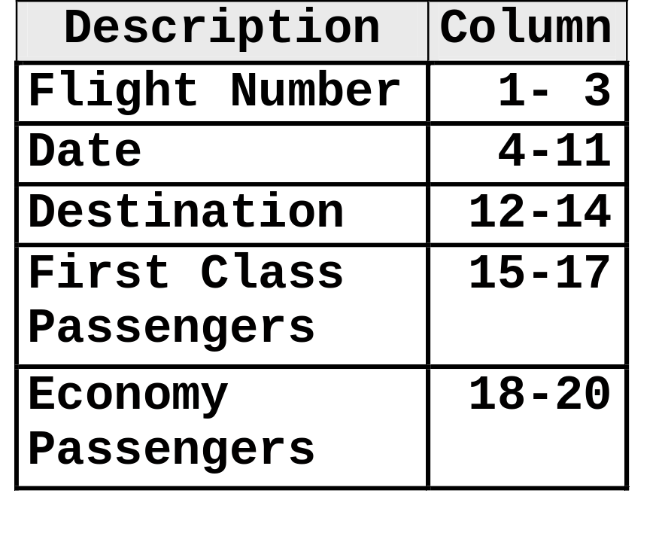
Reading Raw Data Files
Data for flights from New York to Dallas (DFW) and Los Angeles (LAX) is stored in a raw data file. Create a SAS data set from the raw data.
1 1 2
1---5----0----5----0
43912/11/00LAX 20137
92112/11/00DFW 20131
11412/12/00LAX 15170
98212/12/00dfw 5 85
43912/13/00LAX 14196
98212/13/00DFW 15116
43112/14/00LaX 17166
98212/14/00DFW 7 88
11412/15/00LAX 187
98212/15/00DFW 14 31

Slide 4
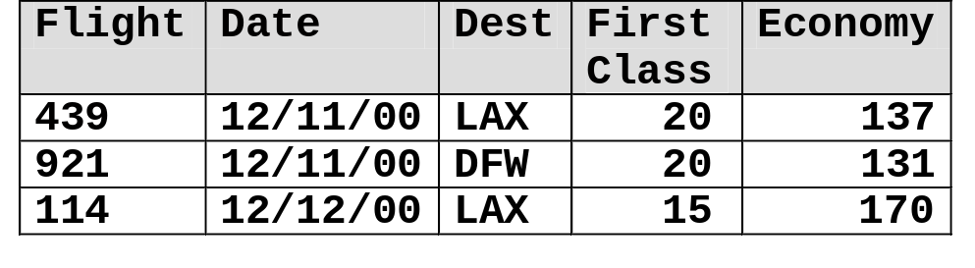
Creating a SAS Data Set
Raw Data File
In order to create a SAS data set from a raw data file, you must
1 1 2
1---5----0----5----0
43912/11/00LAX 20137
92112/11/00DFW 20131
11412/12/00LAX 15170
start a DATA step and name the SAS data set being created (DATA statement)
DATA Step
infile 'raw-data-filename';
run;
input input-specifications;
identify the location of the raw data file to read (INFILE statement)
data SAS-data-set-name;
describe how to read the data fields from the raw data file (INPUT statement).
SAS Data Set
...

Slide 5
Creating a SAS Data Set
Raw Data File
In order to create a SAS data set from a raw data file, you must
1 1 2
1---5----0----5----0
43912/11/00LAX 20137
92112/11/00DFW 20131
11412/12/00LAX 15170
start a DATA step and name the SAS data set being created (DATA statement)
DATA Step
identify the location of the raw data file to read
(INFILE statement)
data SAS-data-set-name;
infile 'raw-data-filename';
input input-specifications;
run;
describe how to read the data fields from the raw data file (INPUT statement).
SAS Data Set

Slide 6
Creating a SAS Data Set
General form of the DATA statement:
Example: This DATA statement creates a temporary SAS data set named dfwlax:
DATA libref.SAS-data-set(s);
data work.dfwlax;
Example: This DATA statement creates a permanent SAS data set named dfwlax:
libname ia 'SAS-data-library';
data ia.dfwlax;
Notes:
Note reminding students about SAS naming conventions
Note: the SAS table(s) created in the DATA statement can be either temporary or permanent.

Slide 7
Pointing to a Raw Data File
General form of the INFILE statement:
Examples:
INFILE ‘filename’ <options>;
z/OS (OS/390)
infile 'userid.prog1.dfwlax';
UNIX
infile '/users/userid/dfwlax.dat';
Windows
infile 'c:\workshop\winsas\prog1\dfwlax.dat';
The PAD option in the INFILE statement is useful for
reading variable-length records typically found in
Windows and UNIX environments.

Slide 8
Reading Data Fields
General form of the INPUT statement:
input-specifications
  names the SAS variables
  identifies the variables as character or numeric
  specifies the locations of the fields in the raw data
  can be specified as column, formatted, list or named input.
INPUT input-specifications;

Slide 9
Reading Data Using Column Input
Column input is appropriate for reading
  data in fixed columns
  standard character and numeric data.
General form of a column INPUT statement:
INPUT variable <$> startcol-endcol . . . ;
Examples of standard numeric data:
15 -15 15.4 +1.23 1.23E3 -1.23E-3

Slide 10
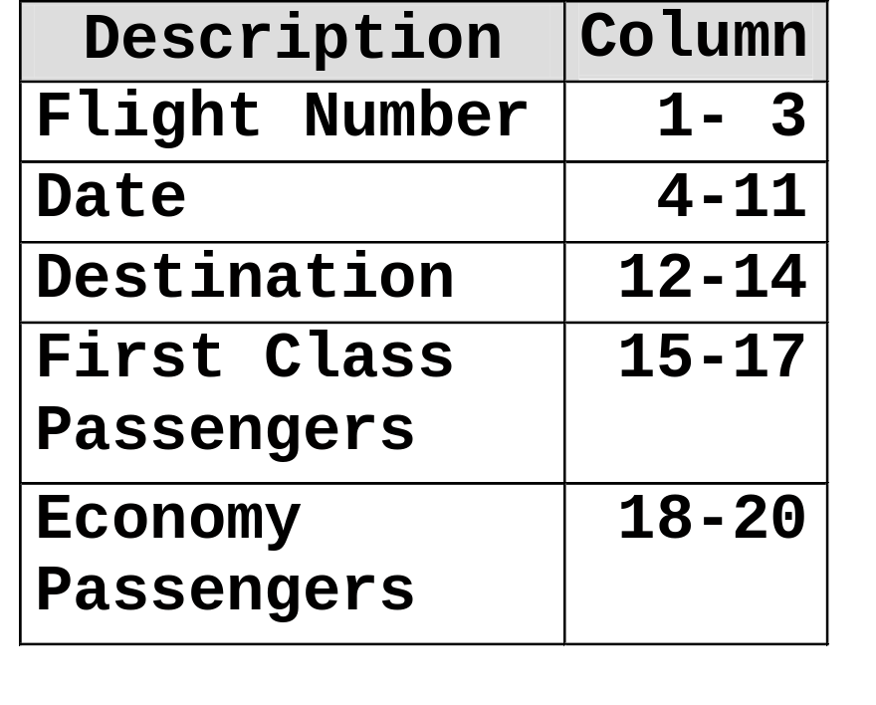
The Raw Data
1 1 2
1---5----0----5----0
43912/11/00LAX 20137
92112/11/00DFW 20131
11412/12/00LAX 15170
98212/12/00dfw 5 85
43912/13/00LAX 14196
98212/13/00DFW 15116
43112/14/00LaX 17166
98212/14/00DFW 7 88
11412/15/00LAX 187
98212/15/00DFW 14 31

Slide 11
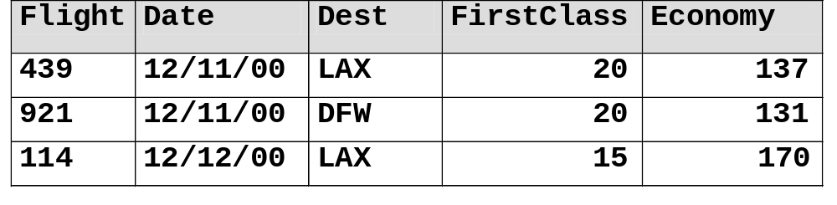
Reading Data Using Column Input
Raw Data File
Read the raw data file using column input.
43912/11/00LAX 20137
92112/11/00DFW 20131
11412/12/00LAX 15170
DATA Step
data SAS-data-set-name;
infile 'raw-data-filename';
input variable <$> startcol-endcol ...;
run;
SAS Data Set

Slide 12
Reading Data Using Column Input
1 1 2
1---5----0----5----0
43912/11/00LAX 20137
92112/11/00DFW 20131
11412/12/00LAX 15170
input Flight $ 1-3 Date $ 4-11
Dest $ 12-14 FirstClass 15-17
Economy 18-20;
...

Slide 13
Reading Data Using Column Input
1 1 2
1---5----0----5----0
43912/11/00LAX 20137
92112/11/00DFW 20131
11412/12/00LAX 15170
input Flight $ 1-3 Date $ 4-11
Dest $ 12-14 FirstClass 15-17
Economy 18-20;
...

Slide 14
Reading Data Using Column Input
1 1 2
1---5----0----5----0
43912/11/00LAX 20137
92112/11/00DFW 20131
11412/12/00LAX 15170
input Flight $ 1-3 Date $ 4-11
Dest $ 12-14 FirstClass 15-17
Economy 18-20;
...

Slide 15
Reading Data Using Column Input
1 1 2
1---5----0----5----0
43912/11/00LAX 20137
92112/11/00DFW 20131
11412/12/00LAX 15170
input Flight $ 1-3 Date $ 4-11
Dest $ 12-14 FirstClass 15-17
Economy 18-20;
...

Slide 16
Reading Data Using Column Input
1 1 2
1---5----0----5----0
43912/11/00LAX 20137
92112/11/00DFW 20131
11412/12/00LAX 15170
input Flight $ 1-3 Date $ 4-11
Dest $ 12-14 FirstClass 15-17
Economy 18-20;
...

Slide 17
Create Temporary SAS Data Sets
Store the dfwlax data set in the work library.
data work.dfwlax;
infile 'raw-data-file';
input Flight $ 1-3 Date $ 4-11
Dest $ 12-14 FirstClass 15-17
Economy 18-20;
run;
NOTE: The data set WORK.DFWLAX has 10 observations and 5
variables.
c06s1d1

Slide 18
Create Permanent SAS Data Sets
Alter the previous DATA step to permanently store the dfwlax data set.
libname ia 'SAS-data-library';
data ia.dfwlax;
infile 'raw-data-file';
input Flight $ 1-3 Date $ 4-11
Dest $ 12-14 FirstClass 15-17
Economy 18-20;
run;
NOTE: The data set IA.DFWLAX has 10 observations and 5
variables.
c06s1d2

Slide 19
Looking Behind the Scenes
  The DATA step is processed in two phases:
  compilation
  execution.
data work.dfwlax;
infile 'raw-data-file';
input Flight $ 1-3 Date $ 4-11
Dest $ 12-14 FirstClass 15-17
Economy 18-20;
run;

Slide 20

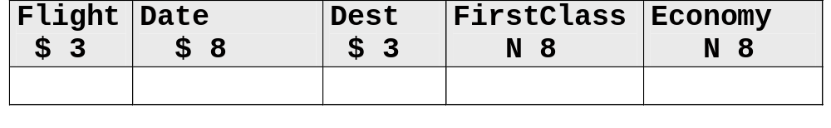
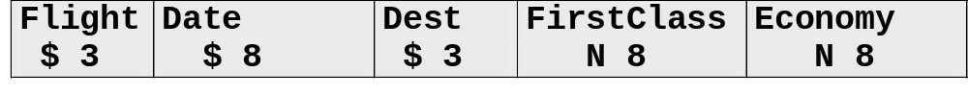
Looking Behind the Scenes
At compile time, SAS creates
  an input buffer to hold the current raw data file record that is being processed
  a program data vector (PDV) to hold the current
  SAS observation
  the descriptor portion of the output data set.

Slide 21
Compiling the DATA Step
data work.dfwlax;
infile 'raw-data-file';
input Flight $ 1-3 Date $ 4-11
Dest $ 12-14 FirstClass 15-17
Economy 18-20;
run;
...

Slide 22
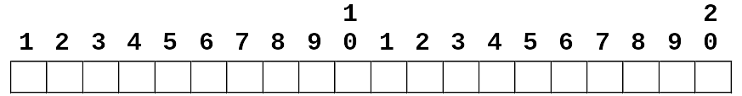
Compiling the DATA Step
data work.dfwlax;
infile 'raw-data-file';
input Flight $ 1-3 Date $ 4-11
Dest $ 12-14 FirstClass 15-17
Economy 18-20;
run;
Input Buffer
...

Slide 23
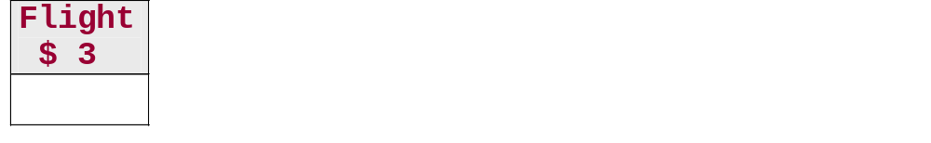
Compiling the DATA Step
data work.dfwlax;
infile 'raw-data-file';
input Flight $ 1-3 Date $ 4-11
Dest $ 12-14 FirstClass 15-17
Economy 18-20;
run;
Input Buffer
PDV
...

Slide 24
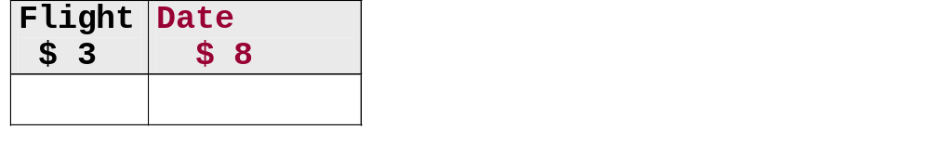
Compiling the DATA Step
data work.dfwlax;
infile 'raw-data-file';
input Flight $ 1-3 Date $ 4-11
Dest $ 12-14 FirstClass 15-17
Economy 18-20;
run;
Input Buffer
PDV
...

Slide 25
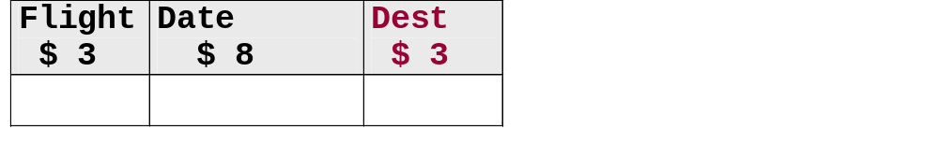
Compiling the DATA Step
data work.dfwlax;
infile 'raw-data-file';
input Flight $ 1-3 Date $ 4-11
Dest $ 12-14 FirstClass 15-17
Economy 18-20;
run;
Input Buffer
PDV
...

Slide 26
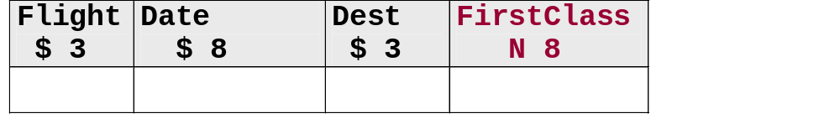
Compiling the DATA Step
data work.dfwlax;
infile 'raw-data-file';
input Flight $ 1-3 Date $ 4-11
Dest $ 12-14 FirstClass 15-17
Economy 18-20;
run;
Input Buffer
PDV
...

Slide 27
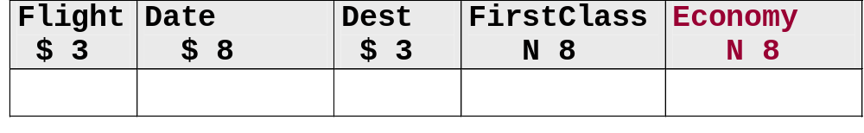
Compiling the DATA Step
data work.dfwlax;
infile 'raw-data-file';
input Flight $ 1-3 Date $ 4-11
Dest $ 12-14 FirstClass 15-17
Economy 18-20;
run;
Input Buffer
PDV
...

Slide 28
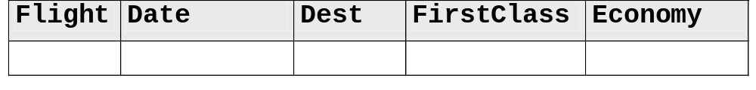
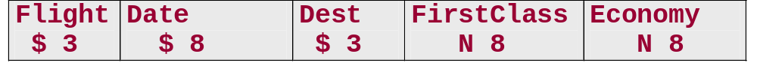
Compiling the DATA Step
data work.dfwlax;
infile 'raw-data-file';
input Flight $ 1-3 Date $ 4-11
Dest $ 12-14 FirstClass 15-17
Economy 18-20;
run;
Input Buffer
PDV
dfwlax descriptor portion
...

Slide 29
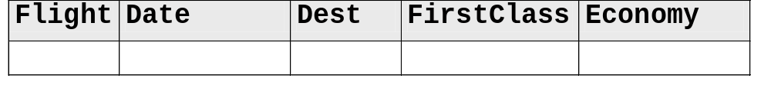
Executing the DATA Step
data work.dfwlax;
infile 'raw-data-file';
input Flight $ 1-3 Date $ 4-11
Dest $ 12-14 FirstClass 15-17
Economy 18-20;
run;
Input Buffer
PDV
dfwlax

Slide 30
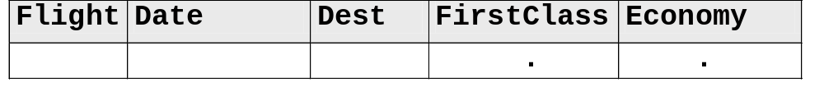
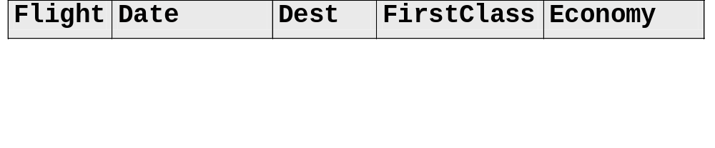
data work.dfwlax;
infile 'raw-data-file';
input Flight $ 1-3 Date $ 4-11
Dest $ 12-14 FirstClass 15-17
Economy 18-20;
run;
43912/11/00LAX 20137
92112/11/00DFW 20131
11412/12/00LAX 15170
Raw Data
Input Buffer
PDV
dfwlax
...

Slide 31
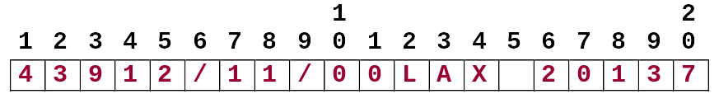
data work.dfwlax;
infile 'raw-data-file';
input Flight $ 1-3 Date $ 4-11
Dest $ 12-14 FirstClass 15-17
Economy 18-20;
run;
43912/11/00LAX 20137
92112/11/00DFW 20131
11412/12/00LAX 15170
Raw Data
Input Buffer
PDV
dfwlax
...

Slide 32
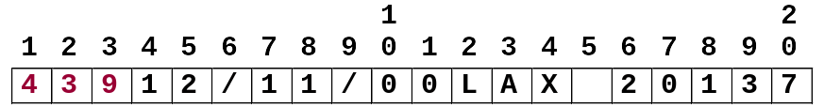
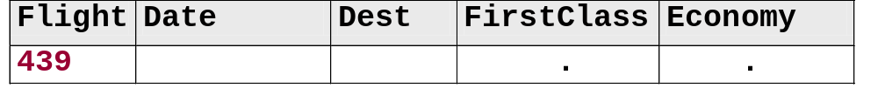
data work.dfwlax;
infile 'raw-data-file';
input Flight $ 1-3 Date $ 4-11
Dest $ 12-14 FirstClass 15-17
Economy 18-20;
run;
43912/11/00LAX 20137
92112/11/00DFW 20131
11412/12/00LAX 15170
Raw Data
Input Buffer
PDV
dfwlax
...

Slide 33
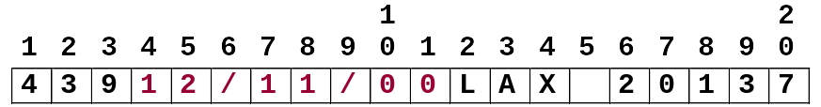
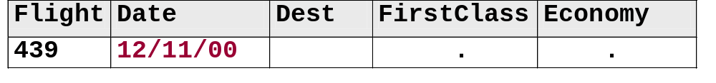
data work.dfwlax;
infile 'raw-data-file';
input Flight $ 1-3 Date $ 4-11
Dest $ 12-14 FirstClass 15-17
Economy 18-20;
run;
43912/11/00LAX 20137
92112/11/00DFW 20131
11412/12/00LAX 15170
Raw Data
Input Buffer
PDV
dfwlax
...

Slide 34
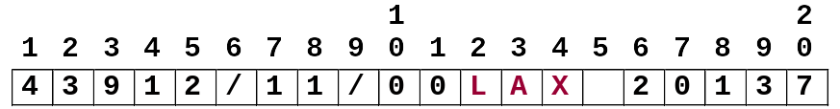
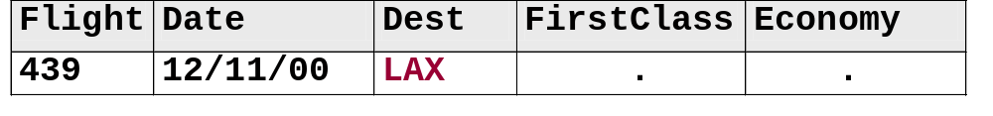
data work.dfwlax;
infile 'raw-data-file';
input Flight $ 1-3 Date $ 4-11
Dest $ 12-14 FirstClass 15-17
Economy 18-20;
run;
43912/11/00LAX 20137
92112/11/00DFW 20131
11412/12/00LAX 15170
Raw Data
Input Buffer
PDV
dfwlax
...

Slide 35
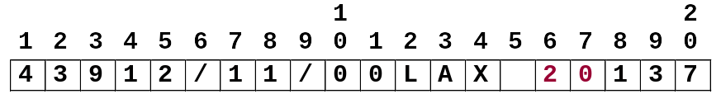
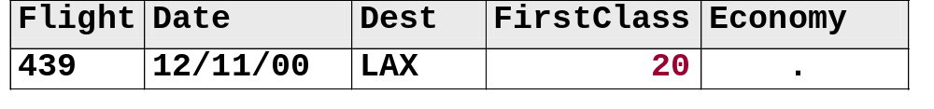
data work.dfwlax;
infile 'raw-data-file';
input Flight $ 1-3 Date $ 4-11
Dest $ 12-14 FirstClass 15-17
Economy 18-20;
run;
43912/11/00LAX 20137
92112/11/00DFW 20131
11412/12/00LAX 15170
Raw Data
Input Buffer
PDV
dfwlax
...

Slide 36
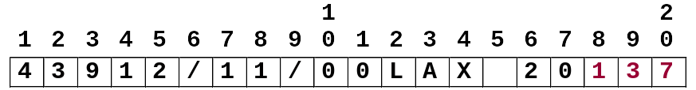
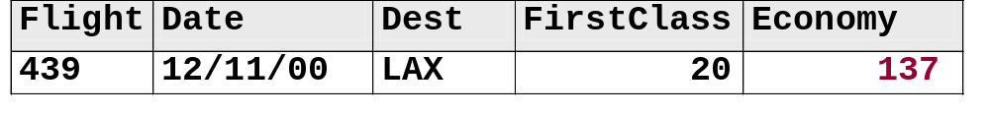
data work.dfwlax;
infile 'raw-data-file';
input Flight $ 1-3 Date $ 4-11
Dest $ 12-14 FirstClass 15-17
Economy 18-20;
run;
43912/11/00LAX 20137
92112/11/00DFW 20131
11412/12/00LAX 15170
Raw Data
Input Buffer
PDV
dfwlax
...

Slide 37
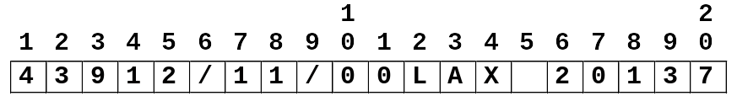
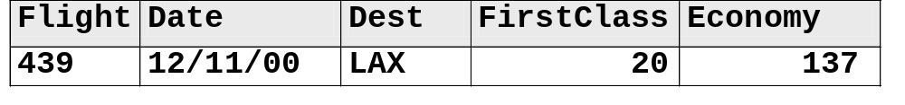
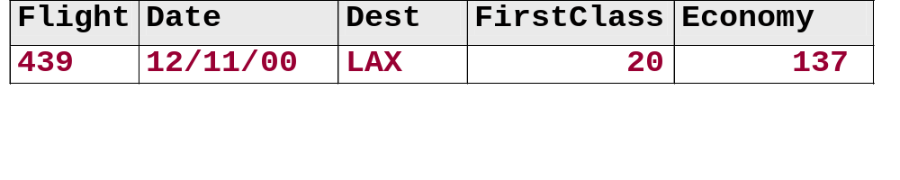
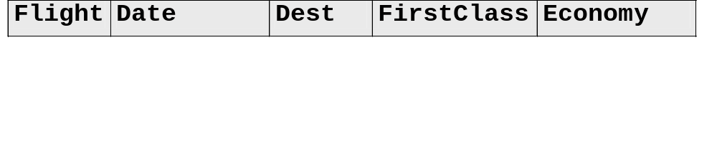
data work.dfwlax;
infile 'raw-data-file';
input Flight $ 1-3 Date $ 4-11
Dest $ 12-14 FirstClass 15-17
Economy 18-20;
run;
Automatic return
43912/11/00LAX 20137
92112/11/00DFW 20131
11412/12/00LAX 15170
Raw Data
Input Buffer
PDV
Automatic output
dfwlax
...

Slide 38
data work.dfwlax;
infile 'raw-data-file';
input Flight $ 1-3 Date $ 4-11
Dest $ 12-14 FirstClass 15-17
Economy 18-20;
run;
43912/11/00LAX 20137
92112/11/00DFW 20131
11412/12/00LAX 15170
Reinitialize variables to missing
Raw Data
Input Buffer
PDV
dfwlax
...

Slide 39
data work.dfwlax;
infile 'raw-data-file';
input Flight $ 1-3 Date $ 4-11
Dest $ 12-14 FirstClass 15-17
Economy 18-20;
run;
43912/11/00LAX 20137
92112/11/00DFW 20131
11412/12/00LAX 15170
Raw Data
Input Buffer
PDV
dfwlax
...

Slide 40
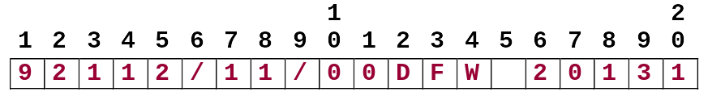
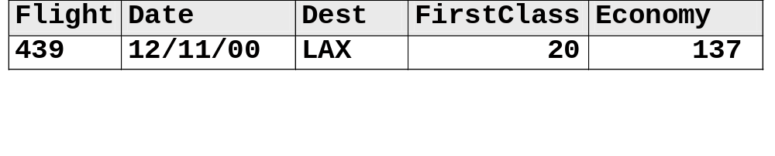
data work.dfwlax;
infile 'raw-data-file';
input Flight $ 1-3 Date $ 4-11
Dest $ 12-14 FirstClass 15-17
Economy 18-20;
run;
43912/11/00LAX 20137
92112/11/00DFW 20131
11412/12/00LAX 15170
Raw Data
Input Buffer
PDV
dfwlax
...

Slide 41
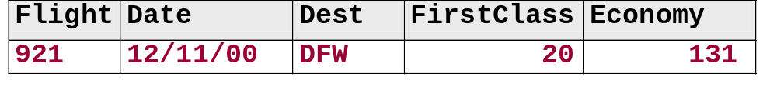
data work.dfwlax;
infile 'raw-data-file';
input Flight $ 1-3 Date $ 4-11
Dest $ 12-14 FirstClass 15-17
Economy 18-20;
run;
43912/11/00LAX 20137
92112/11/00DFW 20131
11412/12/00LAX 15170
Raw Data
Input Buffer
PDV
dfwlax
...

Slide 42
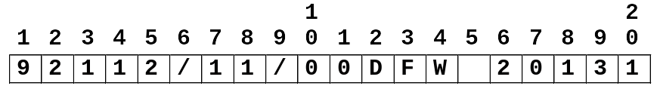
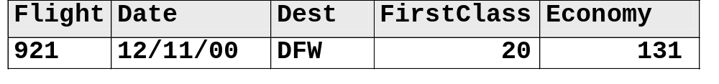
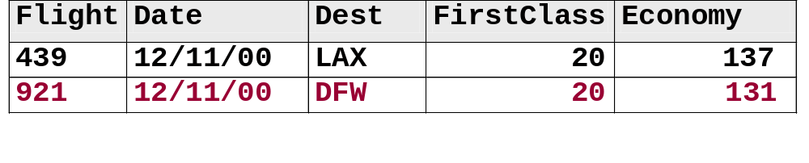
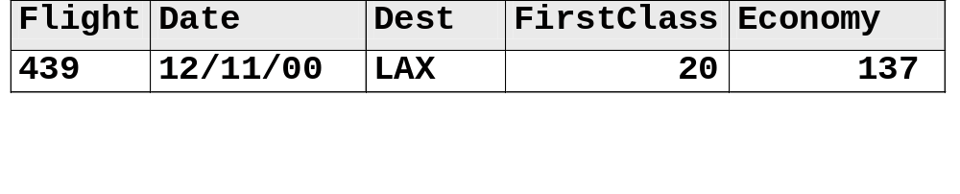
data work.dfwlax;
infile 'raw-data-file';
input Flight $ 1-3 Date $ 4-11
Dest $ 12-14 FirstClass 15-17
Economy 18-20;
run;
Automatic return
43912/11/00LAX 20137
92112/11/00DFW 20131
11412/12/00LAX 15170
Raw Data
Input Buffer
PDV
Automatic output
dfwlax
...

Slide 43
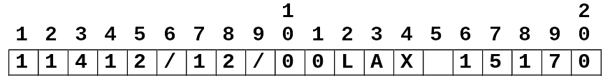
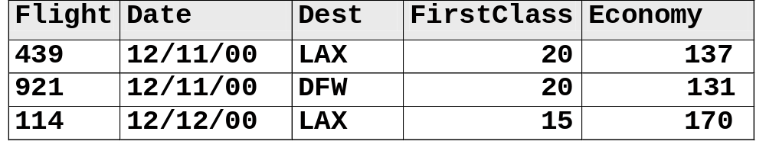
Executing the DATA Step
data work.dfwlax;
infile 'raw-data-file';
input Flight $ 1-3 Date $ 4-11
Dest $ 12-14 FirstClass 15-17
Economy 18-20;
run;
43912/11/00LAX 20137
92112/11/00DFW 20131
11412/12/00LAX 15170
Raw Data
Input Buffer
PDV
dfwlax

Slide 44
DATA Step Execution: Summary
Compile Program
Initialize Variables
to Missing (PDV)
Execute INPUT
Statement
End of
File?
Yes
Execute Other
Statements
Next
Step
No
Output to
SAS Data Set

Slide 45
Access Temporary SAS Data Sets
proc print data=work.dfwlax;
run;
The SAS System
First
Obs Flight Date Dest Class Economy
1 439 12/11/00 LAX 20 137
2 921 12/11/00 DFW 20 131
3 114 12/12/00 LAX 15 170
4 982 12/12/00 dfw 5 85
5 439 12/13/00 LAX 14 196
6 982 12/13/00 DFW 15 116
7 431 12/14/00 LaX 17 166
8 982 12/14/00 DFW 7 88
9 114 12/15/00 LAX . 187
10 982 12/15/00 DFW 14 31
c06s1d1

Slide 46
Access Permanent SAS Data Sets
  To access a permanently stored SAS data set,
  submit a LIBNAME statement to assign a libref to the SAS data library
  use the libref as the first-level name of the SAS data set.
The LIBNAME statement only needs to be submitted once per SAS session.

Slide 47
Access Permanent SAS Data Sets
libname ia 'SAS-data-library';
proc print data=ia.dfwlax;
run;
The SAS System
First
Obs Flight Date Dest Class Economy
1 439 12/11/00 LAX 20 137
2 921 12/11/00 DFW 20 131
3 114 12/12/00 LAX 15 170
4 982 12/12/00 dfw 5 85
5 439 12/13/00 LAX 14 196
6 982 12/13/00 DFW 15 116
7 431 12/14/00 LaX 17 166
8 982 12/14/00 DFW 7 88
9 114 12/15/00 LAX . 187
10 982 12/15/00 DFW 14 31
c06s1d2

Slide 48

Exercises
These exercises reinforce the concepts discussed previously.

Slide 49
Section 6.2
Reading Raw Data Files:
Formatted Input

Slide 50
Objectives
  Read standard and nonstandard character and numeric data using formatted input.
  Read date values and convert them to
  SAS date values.

Slide 51
Reading Data Using Formatted Input
Formatted input is appropriate for reading
  data in fixed columns
  standard and nonstandard character and numeric data
  calendar values to be converted to SAS date values.

Slide 52
Reading Data Using Formatted Input
General form of the INPUT statement with formatted input:
INPUT pointer-control variable informat . . . ;
Formatted input is used to read data values by
  moving the input pointer to the starting position of the field
  specifying a variable name
  specifying an informat.

Slide 53
Reading Data Using Formatted Input
Pointer controls:
@n moves the pointer to column n.
+n moves the pointer n positions.
An informat specifies
  the width of the input field
  how to read the data values that are stored in the field.

Slide 54
What Is a SAS Informat?
An informat is an instruction that SAS uses to read data values.
SAS informats have the following form:
<$>informat-namew.<d>
Indicates a character informat
Number of decimal places
Informat name
Required delimiter
Total width of the field to read

Slide 55
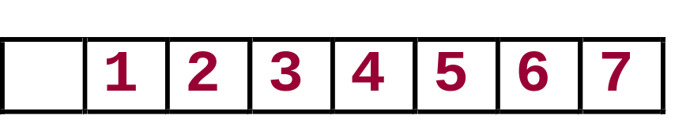
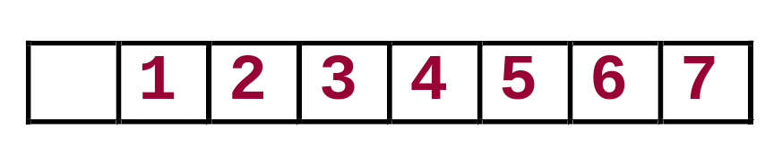
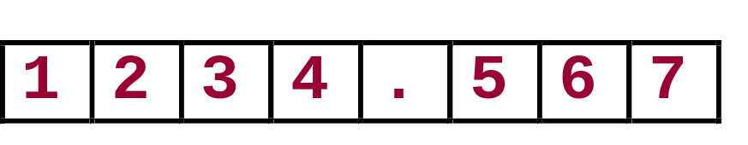
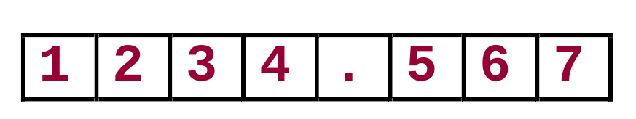
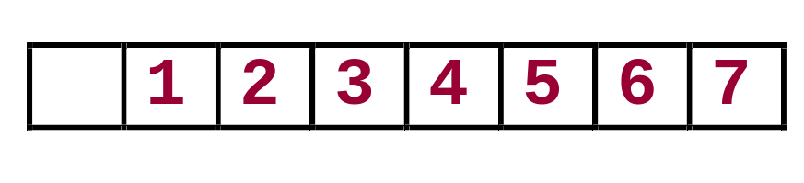
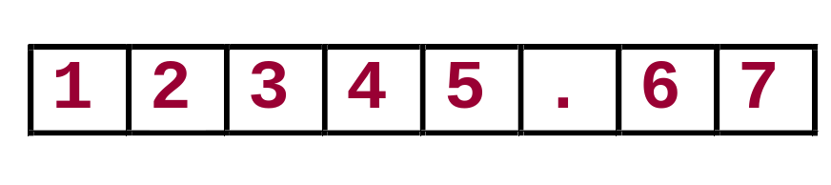
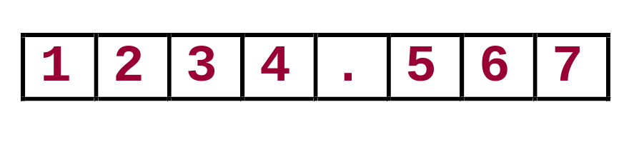
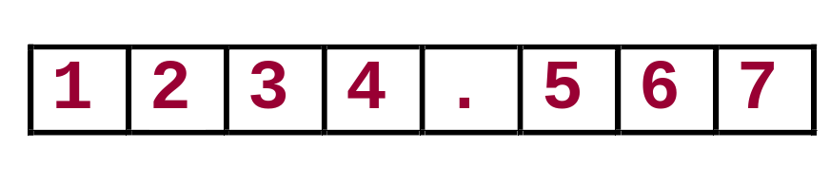
Selected Informats
8. or 8.0 reads 8 columns of numeric data.
Raw Data Value Informat SAS Data Value
8.0
8.0
8.2 reads 8 columns of numeric data and may insert a decimal point in the value.
Raw Data Value Informat SAS Data Value
8.2
8.2

Slide 56




Selected Informats
$8. reads 8 columns of character data and removes leading blanks.
Raw Data Value Informat SAS Data Value
$CHAR8. reads 8 columns of character data and preserves leading blanks.
Raw Data Value Informat SAS Data Value
$8.
$CHAR8.

Slide 57
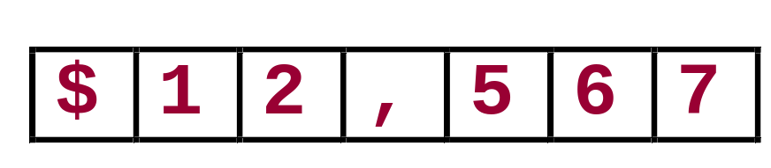



Selected Informats
COMMA7. reads 7 columns of numeric data and removes selected nonnumeric characters such as dollar signs and commas.
Raw Data Value Informat SAS Data Value
MMDDYY8. reads dates of the form 10/29/01.
Raw Data Value Informat SAS Data Value
COMMA7.0
MMDDYY8.

Slide 58
Working with Date Values
Date values that are stored as SAS dates are special numeric values.
A SAS date value is interpreted as the number of days between January 1, 1960, and a specific date.
01JAN1959
01JAN1960
01JAN1961
informat
-365
0
366
format
01/01/1959
01/01/1960
01/01/1961
...

Slide 59
Convert Dates to SAS Date Values
SAS uses date informats to read and convert dates to SAS date values.
Examples:
Raw Data Value
Converted Value
Informat
10/29/2001 MMDDYY10. 15277
10/29/01 MMDDYY8. 15277
29OCT2001 DATE9. 15277
29/10/2001 DDMMYY10. 15277
Number of days between 01JAN1960 and 29OCT2001

Slide 60

Using Formatted Input
Raw Data File
Read the raw data file using formatted input.
43912/11/00LAX 20137
92112/11/00DFW 20131
11412/12/00LAX 15170
DATA Step
data SAS-data-set-name;
infile 'raw-data-filename';
input pointer-control variable informat-name;
run;
SAS Data Set
SAS date values

Slide 61
Reading Data: Formatted Input
1 1 2
1---5----0----5----0
43912/11/00LAX 20137
92112/11/00DFW 20131
11412/12/00LAX 15170
input @1 Flight $3. @4 Date mmddyy8.
@12 Dest $3. @15 FirstClass 3.
@18 Economy 3.;
...

Slide 62
Reading Data: Formatted Input
1 1 2
1---5----0----5----0
43912/11/00LAX 20137
92112/11/00DFW 20131
11412/12/00LAX 15170
input @1 Flight $3. @4 Date mmddyy8.
@12 Dest $3. @15 FirstClass 3.
@18 Economy 3.;
...

Slide 63
Reading Data: Formatted Input
1 1 2
1---5----0----5----0
43912/11/00LAX 20137
92112/11/00DFW 20131
11412/12/00LAX 15170
input @1 Flight $3. @4 Date mmddyy8.
@12 Dest $3. @15 FirstClass 3.
@18 Economy 3.;
...

Slide 64
Reading Data: Formatted Input
1 1 2
1---5----0----5----0
43912/11/00LAX 20137
92112/11/00DFW 20131
11412/12/00LAX 15170
input @1 Flight $3. @4 Date mmddyy8.
@12 Dest $3. @15 FirstClass 3.
@18 Economy 3.;
...

Slide 65
Reading Data: Formatted Input
1 1 2
1---5----0----5----0
43912/11/00LAX 20137
92112/11/00DFW 20131
11412/12/00LAX 15170
input @1 Flight $3. @4 Date mmddyy8.
@12 Dest $3. @15 FirstClass 3.
@18 Economy 3.;
...

Slide 66
Reading Data: Formatted Input
1 1 2
1---5----0----5----0
Raw Data File
43912/11/00LAX 20137
92112/11/00DFW 20131
11412/12/00LAX 15170
data work.dfwlax;
infile 'raw-data-file';
input @1 Flight $3. @4 Date mmddyy8.
@12 Dest $3. @15 FirstClass 3.
@18 Economy 3.;
run;
c06s2d1

Slide 67
Reading Data: Formatted Input
proc print data=work.dfwlax;
run;
SAS date values
The SAS System
First
Obs Flight Date Dest Class Economy
1 439 14955 LAX 20 137
2 921 14955 DFW 20 131
3 114 14956 LAX 15 170
4 982 14956 dfw 5 85
5 439 14957 LAX 14 196
6 982 14957 DFW 15 116
7 431 14958 LaX 17 166
8 982 14958 DFW 7 88
9 114 14959 LAX . 187
10 982 14959 DFW 14 31
c06s2d1

Slide 68
Reading Data: Formatted Input
proc print data=work.dfwlax;
format Date date9.;
run;
Formatted SAS
date values
The SAS System
First
Obs Flight Date Dest Class Economy
1 439 11DEC2000 LAX 20 137
2 921 11DEC2000 DFW 20 131
3 114 12DEC2000 LAX 15 170
4 982 12DEC2000 dfw 5 85
5 439 13DEC2000 LAX 14 196
6 982 13DEC2000 DFW 15 116
7 431 14DEC2000 LaX 17 166
8 982 14DEC2000 DFW 7 88
9 114 15DEC2000 LAX . 187
10 982 15DEC2000 DFW 14 31
c06s2d2

Slide 69
Exercises
These exercises reinforce the concepts discussed previously.

Slide 70
Section 6.3
Examining Data Errors

Slide 71
Objectives
  Define types of data errors.
  Identify data errors.

Slide 72
What Are Data Errors?
SAS detects data errors when
  the INPUT statement encounters invalid data in a field
  illegal arguments are used in functions
  impossible mathematical operations are requested.

Slide 73
Examining Data Errors
When SAS encounters a data error,
  1. a note that describes the error is printed in the
  SAS log
  2. the input record being read is displayed in the
  SAS log (contents of the input buffer)
  3. the values in the SAS observation being created
  are displayed in the SAS log (contents of the PDV)
  4. a missing value is assigned to the appropriate
  SAS variable
  5. execution continues.

Slide 74

Examining Data Errors
c06s3d1.sas
userid.prog1.sascode(c06s3d1)
c06s3d2.sas
userid.prog1.sascode(c06s3d2)
This demonstration illustrates how to examine data errors.

Slide 75
Exercises
These exercises reinforce the concepts discussed previously.

Slide 76
Section 6.4
Assigning Variable Attributes

Slide 77
Objectives
  Assign permanent attributes to SAS variables.
  Override permanent variable attributes.

Slide 78
Default Variable Attributes
When a variable is created in a DATA step, the
  name, type, and length of the variable are automatically assigned
  remaining attributes such as label and format are not automatically assigned.
When the variable is used in a later step,
  the name is displayed for identification purposes
  its value is displayed using a system-determined format.

Slide 79
Default Variable Attributes
Create the ia.dfwlax data set.
libname ia 'SAS-data-library';
data ia.dfwlax;
infile 'raw-data-file';
input @1 Flight $3. @4 Date mmddyy8.
@12 Dest $3. @15 FirstClass 3.
@18 Economy 3.;
run;
c06s4d1

Slide 80
Default Variable Attributes
Examine the descriptor portion of the ia.dfwlax data set.
proc contents data=ia.dfwlax;
run;
Partial Output
Alphabetic List of Variables and Attributes
# Variable Type Len
2 Date Num 8
3 Dest Char 3
5 Economy Num 8
4 FirstClass Num 8
1 Flight Char 3
c06s4d1

Slide 81
Specifying Variable Attributes
Use LABEL and FORMAT statements in the
  PROC step to temporarily assign the attributes (for the duration of the step only)
  DATA step to permanently assign the attributes (stored in the data set descriptor portion).

Slide 82
Temporary Variable Attributes
Use LABEL and FORMAT statements in a PROC step to temporarily assign attributes.
proc print data=ia.dfwlax label;
format Date mmddyy10.;
label Dest='Destination'
FirstClass='First Class Passengers'
Economy='Economy Passengers';
run;
c06s4d1

Slide 83
Temporary Variable Attributes
The SAS System
First
Class Economy
Obs Flight Date Destination Passengers Passengers
1 439 12/11/2000 LAX 20 137
2 921 12/11/2000 DFW 20 131
3 114 12/12/2000 LAX 15 170
4 982 12/12/2000 dfw 5 85
5 439 12/13/2000 LAX 14 196
6 982 12/13/2000 DFW 15 116
7 431 12/14/2000 LaX 17 166
8 982 12/14/2000 DFW 7 88
9 114 12/15/2000 LAX . 187
10 982 12/15/2000 DFW 14 31

Slide 84
Permanent Variable Attributes
Assign labels and formats in the DATA step.
libname ia 'SAS-data-library';
data ia.dfwlax;
infile 'raw-data-file';
input @1 Flight $3. @4 Date mmddyy8.
@12 Dest $3. @15 FirstClass 3.
@18 Economy 3.;
format Date mmddyy10.;
label Dest='Destination'
FirstClass='First Class Passengers'
Economy='Economy Passengers';
run;
c06s4d2

Slide 85
Permanent Variable Attributes
Examine the descriptor portion of the ia.dfwlax data set.
proc contents data=ia.dfwlax;
run;
Partial Output
Alphabetic List of Variables and Attributes
# Variable Type Len Format Label
2 Date Num 8 MMDDYY10.
3 Dest Char 3 Destination
5 Economy Num 8 Economy Passengers
4 FirstClass Num 8 First Class Passengers
1 Flight Char 3
c06s4d2

Slide 86
Permanent Variable Attributes
proc print data=ia.dfwlax label;
run;
The SAS System
First
Class Economy
Obs Flight Date Destination Passengers Passengers
1 439 12/11/2000 LAX 20 137
2 921 12/11/2000 DFW 20 131
3 114 12/12/2000 LAX 15 170
4 982 12/12/2000 dfw 5 85
5 439 12/13/2000 LAX 14 196
6 982 12/13/2000 DFW 15 116
7 431 12/14/2000 LaX 17 166
8 982 12/14/2000 DFW 7 88
9 114 12/15/2000 LAX . 187
10 982 12/15/2000 DFW 14 31
c06s4d2

Slide 87
Override Permanent Attributes
Use a FORMAT statement in a PROC step to temporarily override the format stored in the data set descriptor.
proc print data=ia.dfwlax label;
format Date date9.;
run;
c06s4d3

Slide 88
Override Permanent Attributes
The SAS System
First
Class Economy
Obs Flight Date Destination Passengers Passengers
1 439 11DEC2000 LAX 20 137
2 921 11DEC2000 DFW 20 131
3 114 12DEC2000 LAX 15 170
4 982 12DEC2000 dfw 5 85
5 439 13DEC2000 LAX 14 196
6 982 13DEC2000 DFW 15 116
7 431 14DEC2000 LaX 17 166
8 982 14DEC2000 DFW 7 88
9 114 15DEC2000 LAX . 187
10 982 15DEC2000 DFW 14 31

Slide 89
Exercises
These exercises reinforce the concepts discussed previously.

Slide 90
Section 6.5
Changing Variable Attributes (Self-Study)

Slide 91
Objectives
  Use features in the windowing environment to change variable attributes.
  Use programming statements to change variable attributes.

Slide 92
Changing Variable Attributes
This demonstration illustrates using the SAS windowing environment to change variable attributes under the SAS windowing environment.

Slide 93
The DATASETS Procedure
You can use the DATASETS procedure to modify a variable’s
  name
  label
  format
  informat.

Slide 94
The DATASETS Procedure
General form of PROC DATASETS for changing variable attributes:
PROC DATASETS LIBRARY=libref ;
MODIFY SAS-data-set ;
RENAME old-name-1=new-name-1
<. . . old-name-n=new-name-n>;
LABEL variable-1='label-1'
<. . . variable-n='label-n'>;
FORMAT variable-list-1 format-1
<. . . variable-list-n format-n>;
INFORMAT variable-list-1 informat-1
<. . . variable-list-n informat-n>;
RUN;

Slide 95
Data Set Contents
Use the DATASETS procedure to change the name of the variable Dest to Destination.
Look at the attributes of the variables in the ia.dfwlax data set.
proc contents data=ia.dfwlax;
run;
Alphabetic List of Variables and Attributes
# Variable Type Len
2 Date Num 8
3 Dest Char 3
5 Economy Num 8
4 FirstClass Num 8
1 Flight Char 3
c06s5d1

Slide 96
The DATASETS Procedure
Rename the variable Dest to Destination.
proc datasets library=ia;
modify dfwlax;
rename Dest=Destination;
run;
c06s5d1

Slide 97
Data Set Contents
Look at the attributes of the variables in the ia.dfwlax data set after running PROC DATASETS.
proc contents data=ia.dfwlax;
run;
Alphabetic List of Variables and Attributes
# Variable Type Len
2 Date Num 8
3 Destination Char 3
5 Economy Num 8
4 FirstClass Num 8
1 Flight Char 3
c06s5d1

Slide 98
Exercises
These exercises reinforce the concepts discussed previously.

Slide 99
Section 6.6
Reading Excel Spreadsheets
(Self-Study)

Slide 100
Objectives
  Create a SAS data set from an Excel spreadsheet using the Import Wizard.
  Create a SAS data set from an Excel spreadsheet using the IMPORT procedure.

Slide 101


Business Task
The flight data for Dallas and Los Angeles are in an Excel spreadsheet. Read the data into a SAS data set.
Excel Spreadsheet
SAS Data Set
SAS Data Set

Slide 102
The Import Wizard
The Import Wizard is a point-and-click graphical interface that enables you to create a SAS data set from several types of external files including
  dBASE files (*.DBF)
  Excel spreadsheets (*.XLS)
  Microsoft Access tables (*.MDB)
  JMP data files (*.JMP)
  delimited files (*.*)
  comma-separated values (*.CSV).

Slide 103
Reading Raw Data with the Import Wizard
c06s6d1.sas
This demonstration illustrates using the Import Wizard to create a SAS data set from an Excel spreadsheet.

Slide 104
The IMPORT Procedure
General form of the IMPORT procedure:
PROC IMPORT OUT=SAS-data-set DATAFILE='external-file-name‘
< DBMS=file-type > <REPLACE>;
RUN;
REPLACE
overwrites an existing SAS data set.

Slide 105
Reading Excel Data with PROC IMPORT
PROC IMPORT code to read the Excel file processed through the Import Wizard:
PROC IMPORT OUT=WORK.DFWLAX
DATAFILE="DallasLA.xls"
DBMS=EXCEL2000 REPLACE;
MIXED=YES;
RUN;
MIXED=YES;
converts numeric data values into character data
values for a column that contains mixed data types.
c06s6d2

Slide 106
Reading Tab-Delimited Data
What if the data in the previous example were stored in a tab-delimited file?
Change the PROC IMPORT code to read the
tab-delimited file.
PROC IMPORT OUT= WORK.DFWLAX
DATAFILE= "DallasLA.txt"
DBMS=TAB REPLACE;
RUN;
c06s6d3

Slide 107
Excel SAS/ACCESS LIBNAME Engine
If you wish to access Excel data without making a copy as a SAS data set, use the Excel LIBNAME statement.
General form of an Excel LIBNAME statement:
Example:
LIBNAME libref 'location-of-Excel-workbook' <options>;
libname myxls 'c:\temp\sales.xls';

Slide 108
Excel SAS/ACCESS LIBNAME Engine
The entire Excel workbook is treated like a SAS library.
Individual worksheets and named ranges are considered equivalent to SAS data sets.
Use PROC PRINT to display data from the DFWLAX worksheet in the Excel workbook named DallasLA.xls:
libname xlsdata 'DallasLA.xls';
proc print data=xlsdata.dfwlax;
run;
c06s6d4

Slide 109
Exercises
These exercises reinforce the concepts discussed previously.

